Slide 1

BABY CRY DETECTION
Examination Committee:
Dr. Mongkol Ekpanyapong (Chairperson)
Assoc.Prof. Erik L.J. B(Member)
Dr.A.M. Harsha Abeykoon(Member)
- Prashanth Kolaneru 118307

Slide 2
CONTENTS
PROBLEM STATEMENT
OBJECTIVES
METHODOLGY
RESULTS
CONCLUSION
SCOPE & LIMITATIONS

Slide 3
PROBLEM STATEMENT
Today’s baby monitor device is not accurate to monitor baby cry because of lot false detection. There is no intelligent system in the market to detect infant cry accurately. In order to overcome false detection a system needed to design for detect infant cry accurately.
The proposed system is build with machine learning and Artificial neural network algorithms with model accuracy is 99%.

Slide 4
PROBLEM STATEMENT
Stethoscope that are currently in the market are acoustic sound devices that are purely passive mechanical parts to isolate and focus sound generated by the body. The simplicity of such devices in over showed by poor sound quality. These devices are also difficult to interface with modern technologies such as computers to record and analyse body sound.

Slide 5
OBJECTIVES
The Overall objectives of this thesis is:
Build the Artificial Neural Network deep learning model to detect baby cry.
Export the model to raspberry pi and test the system in real-time with baby cry input taken from mic.
An alert based system would also be designed to send the SMS alerts to registered mobile.

Slide 6
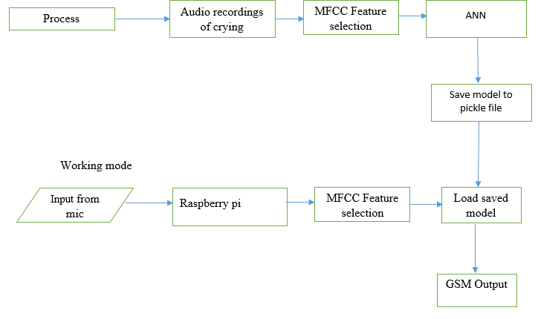
METHODOLOGY
Methodology divided into two parts:
ANN model building.
Testing using raspberry pi in real-time.
Training
Testing

Slide 7
ANN MODEL BUILDING
Dataset
It is taken from DOI: http://dx.doi.org/10.1145/2733373.2806390
Dataset consist of baby cry recordings and non-baby cry recordings(all sounds except baby cry)
Two classes
baby cry
Non-baby cry

Slide 8
AUDIO SIGNAL PRE-PROCESSING
AUDIO DATA
Baby cry audio
Non-baby cry audio
MFCC
MFCC
Label baby cry target as 1
Label non-baby cry target as 0
MODEL

Slide 9
MFCC
MFCCs are the Mel Frequency Cepstral Coefficients.
MFCC takes into account human perception for sensitivity at appropriate frequencies by converting the conventional frequency to Mel Scale, and are thus suitable for speech recognition tasks.
The Mel scale relates perceived frequency, or pitch, of a pure tone to its actual measured frequency. Humans are much better at discerning small changes in pitch at low frequencies than they are at high frequencies. Incorporating this scale makes our features match more closely what humans hear.
We generally take 12-13 Mel Frequency coefficients into consideration as features when training models.

Slide 10
Steps involved in find MFCC COFFICIENTS
Raw signal
Split the signal into frames
Apply fft to get periodogram of each frame
Apply triangular filter to periodogram to get filter bank coefficients
Apply DCT to filter bank coefficients to get 13 MFCC coefficients
Selecting 13 MFCC coefficients

Slide 11
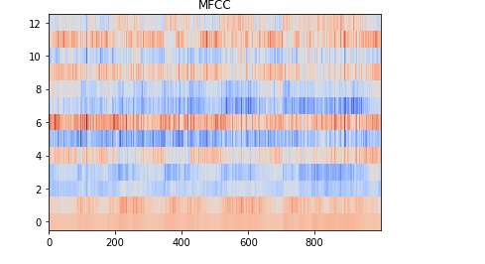
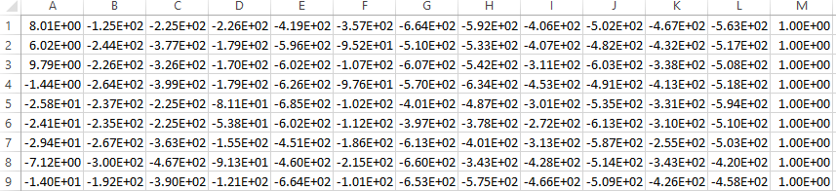
MFCC OUTPUT
MFCC
Coefficients
Time

Slide 12
ARTIFICIAL NEURAL NETWORKS
Models in Keras are defined as sequence of layers
The first hidden layer was set to be 64
The second layer was set to be 32
The output layer was set to be 1
the sigmoid activation function was used for the third layer, which is the output layer.
Sigmoid was used to achieve a binary output, it ensure that the output is between 0 and 1
Learning rate is 0.0005 with optimizer Adam( update network weights iterative based in training data.).

Slide 13
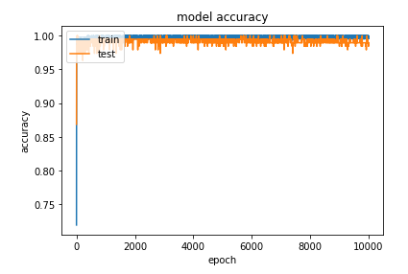
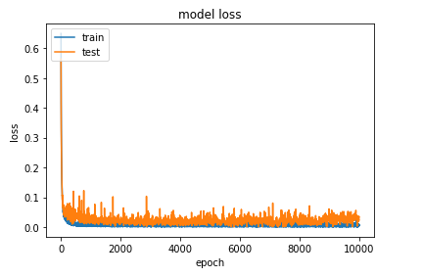
ANN MODEL ACCURACY RESULTS
Training accuracy 99.85% & Testing accuracy 98.95%

Slide 14
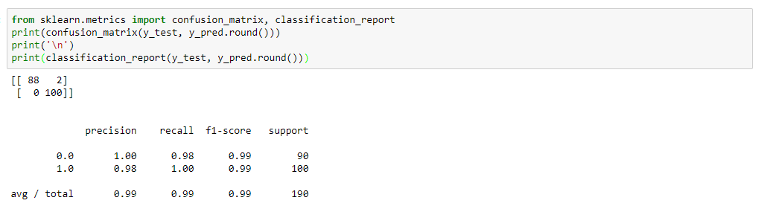
ANN MODEL CLASSIFICATION REPORT

Slide 15
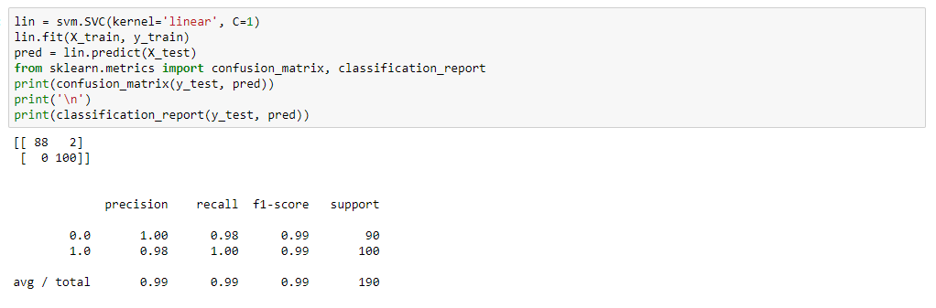
SVM LINEAR KERNEL CLASSIFICATION REPORT

Slide 16
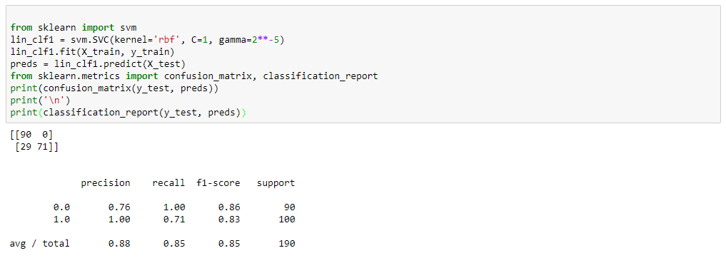
SVM RBF KERNEL CLASSIFICATION REPORT

Slide 17
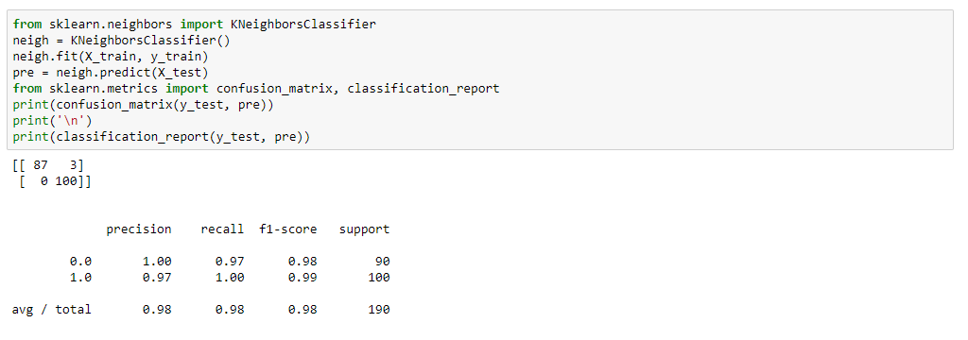
KNN ALGORITHM CLASSIFICATION REPORT

Slide 18
COMPARING DIFFERENT MODEL PERFORMANCE
MODELS | TRAINING ACCURACY | TESTING ACCURACY
ANN | 99% | 98%
SVM-LINEAR | 99% | 98%
SVM-RBF | 99% | 84%
KNN | 98% | 98%

Slide 19
HARDWARE SETUP
Save the model in raspberry pi b
Take input from mic in real-time
When cry is detected then send SMS to registered mobile number.
Microphone input
Raspberry pi
GSM output

Slide 20
MICROPHONE SETUP
Raspberry pi audio port is open with pyaudio
Streamed the audio as byte in smaller chuck sizes(5 sec)
Chuck sizes was converted into temporary wave file in storage
Process repeats for every 5 secs
ANN model
Predict output

Slide 21
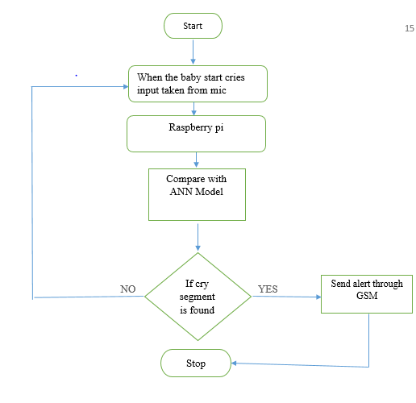
FLOW CHART OF RASPBERRY PI PART

Slide 22

REAL-TIME TESTING OUTPUT

Slide 23
CONCLUSION
Highest training accuracy is obtained for both ANN(training accuracy 99% and test accuracy 98.73%) model and SVM –linear kernel (training accuracy 99% and test accuracy 98.59%) both of them almost had same performance. This models deployed in raspberry pi to test in real-time.

Slide 24
SCOPE & LIMITATIONS
This system can be integrated in many ways to show output.
Like play a music when baby cries
Video monitoring.
The limitations of the system is high sensitive to loud noise(false alarms).

Slide 25
THANK YOU

